Slide 1
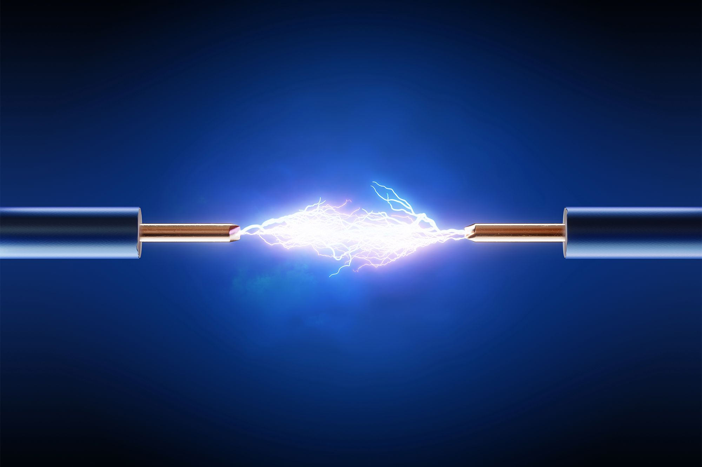

Homopolar Motors
IEEE & SWE UCF

Slide 2
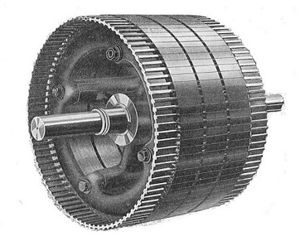
What is a motor?

Slide 3
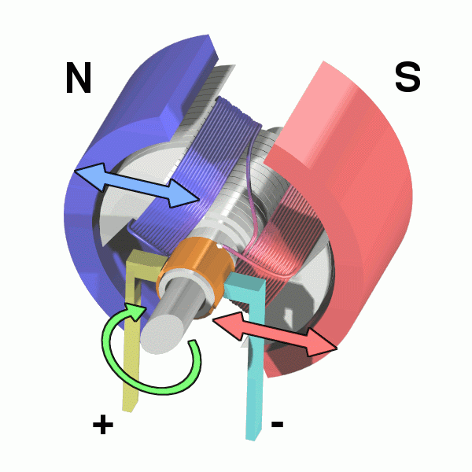
Motor:
A machine, especially one powered by electricity or chemical reactions, that supplies motive power for a vehicle or for some other device with moving parts.

Slide 4
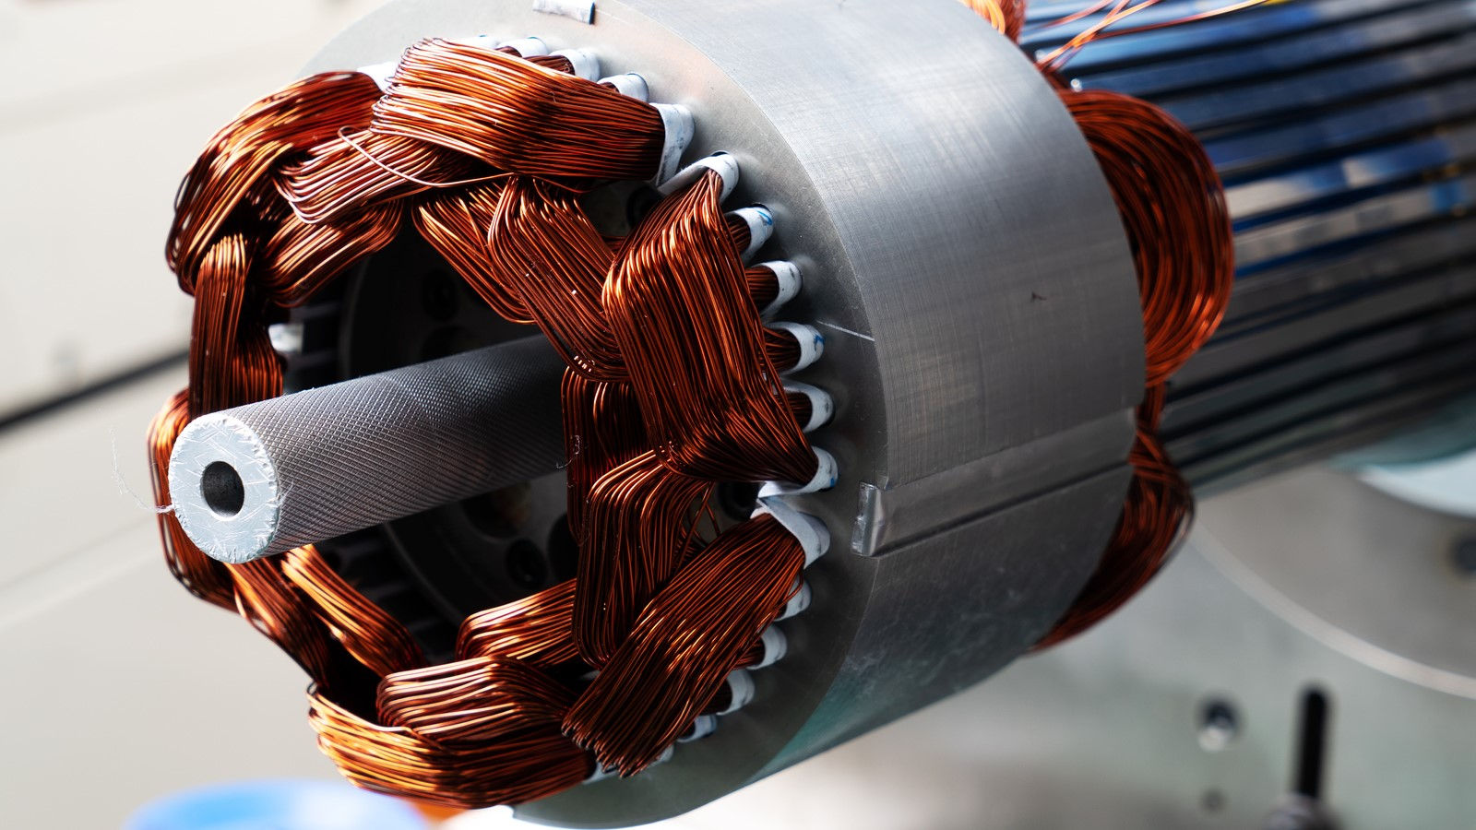
How do electric motors work?

Slide 5
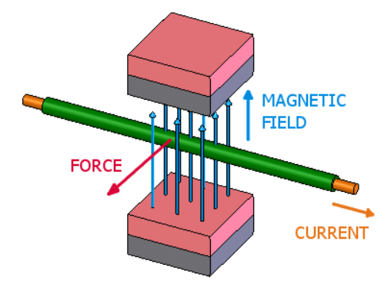
Boils down to this:
If you have an electric current flowing through a wire that happens to be in a magnetic field, it feels a force push on it.

Slide 6
+
2. Magnetic
Field
1. Current
3. Force

Slide 7
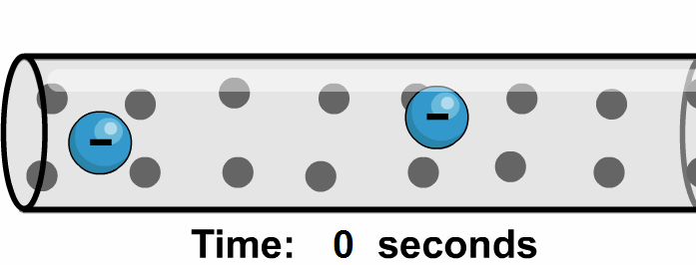
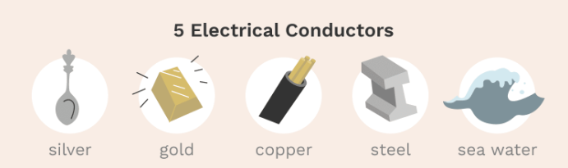
1. Current
An electric current is the physical phenomenon of the flow of an electric charge, usually of electrons, by means of a conductive material.

Slide 8
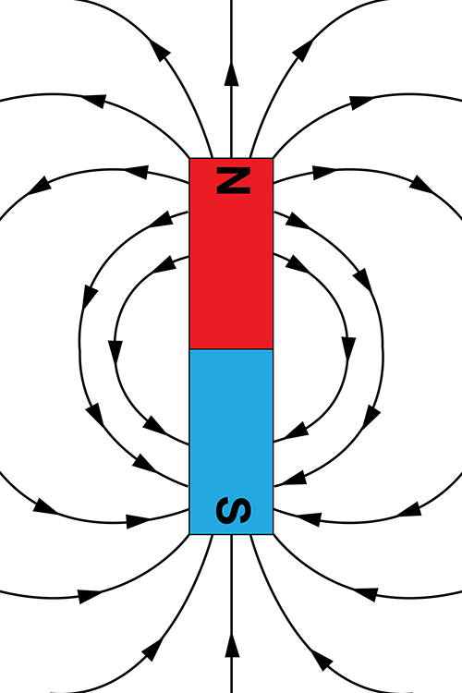
2. Magnetic Field
A magnetic field is a physical field that describes the magnetic influence on moving electric charges, electric currents, and magnetic materials

Slide 9


Slide 10
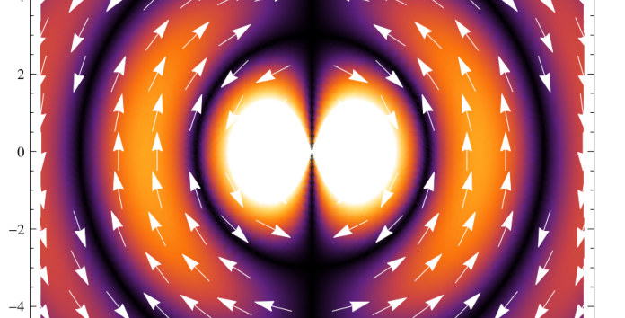
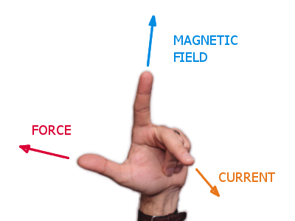
3. Force
Lorentz Force: Force experienced by a charged particle moving through both electric and magnetic fields.
Left Hand Rule

Slide 12
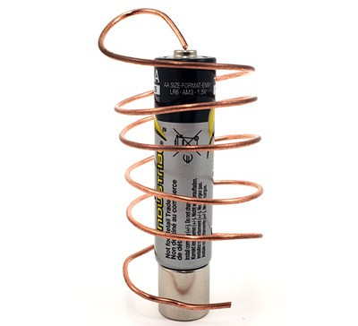
Homopolar Motor
William Thomson, inspired by the experiments of Michael Faraday, created the first homopolar motor in 1879.
Scientists like Albert Einstein were known to have experimented with homopolar motors as part of their research.
Represents an important milestone in the development of electric motors.
Wire (Copper)
Battery
(Power Source)
Magnet

Slide 13
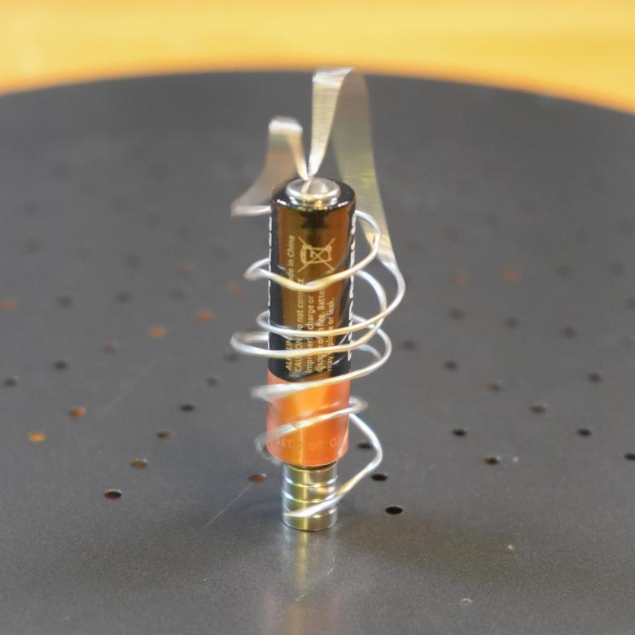
How does it work?

Slide 14
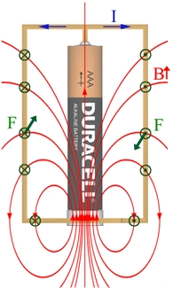
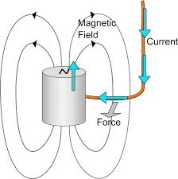
With both current and a magnetic field present, force on the wire is introduced, causing it to rotate
Note:

Slide 15
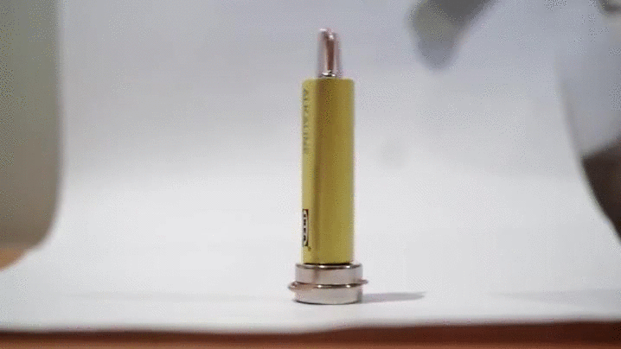
Let's Make Our Own!

Slide 16
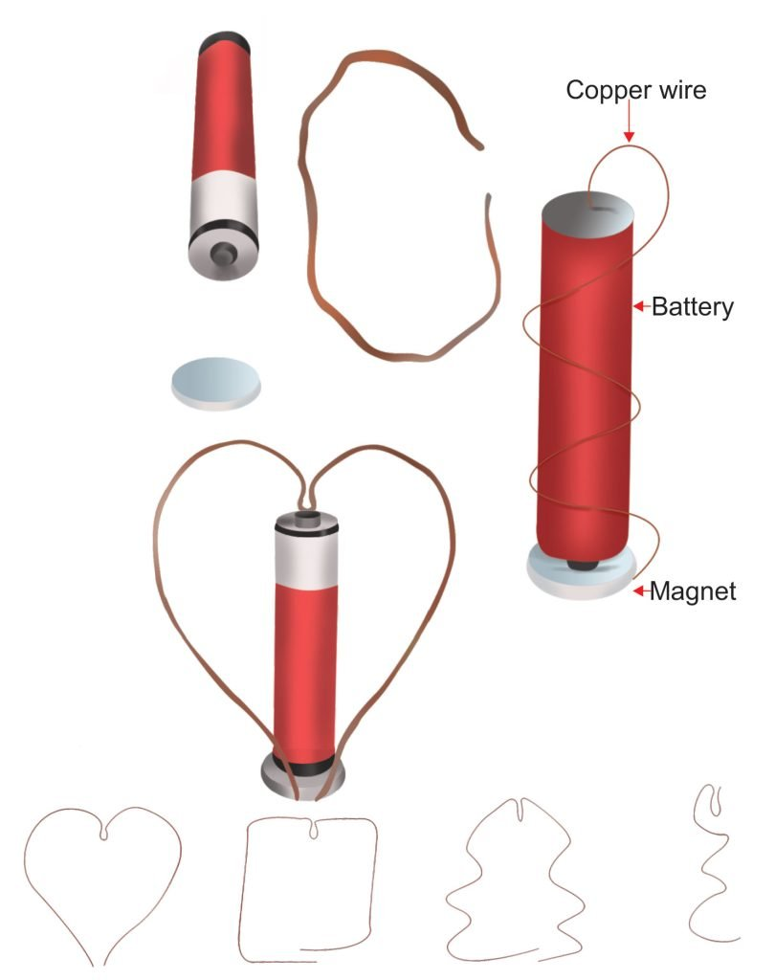
Steps to Assemble
Assembling the Motor:
The copper wire is bent into a loop or semi-circle shape
The wire should be balanced and free to rotate.
Electrical Connection:
One end of the wire is connected to the positive terminal of the power source.
The other end is connected to the negative terminal of the power source (next to magnet).

Slide 17
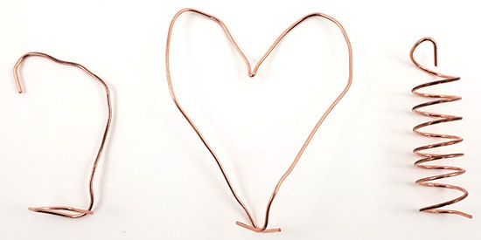
Get Creative!

Slide 18

Let's
Build!

Slide 20
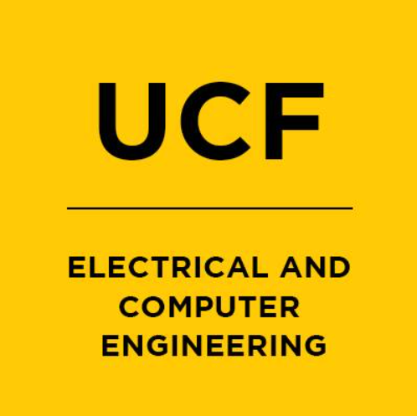
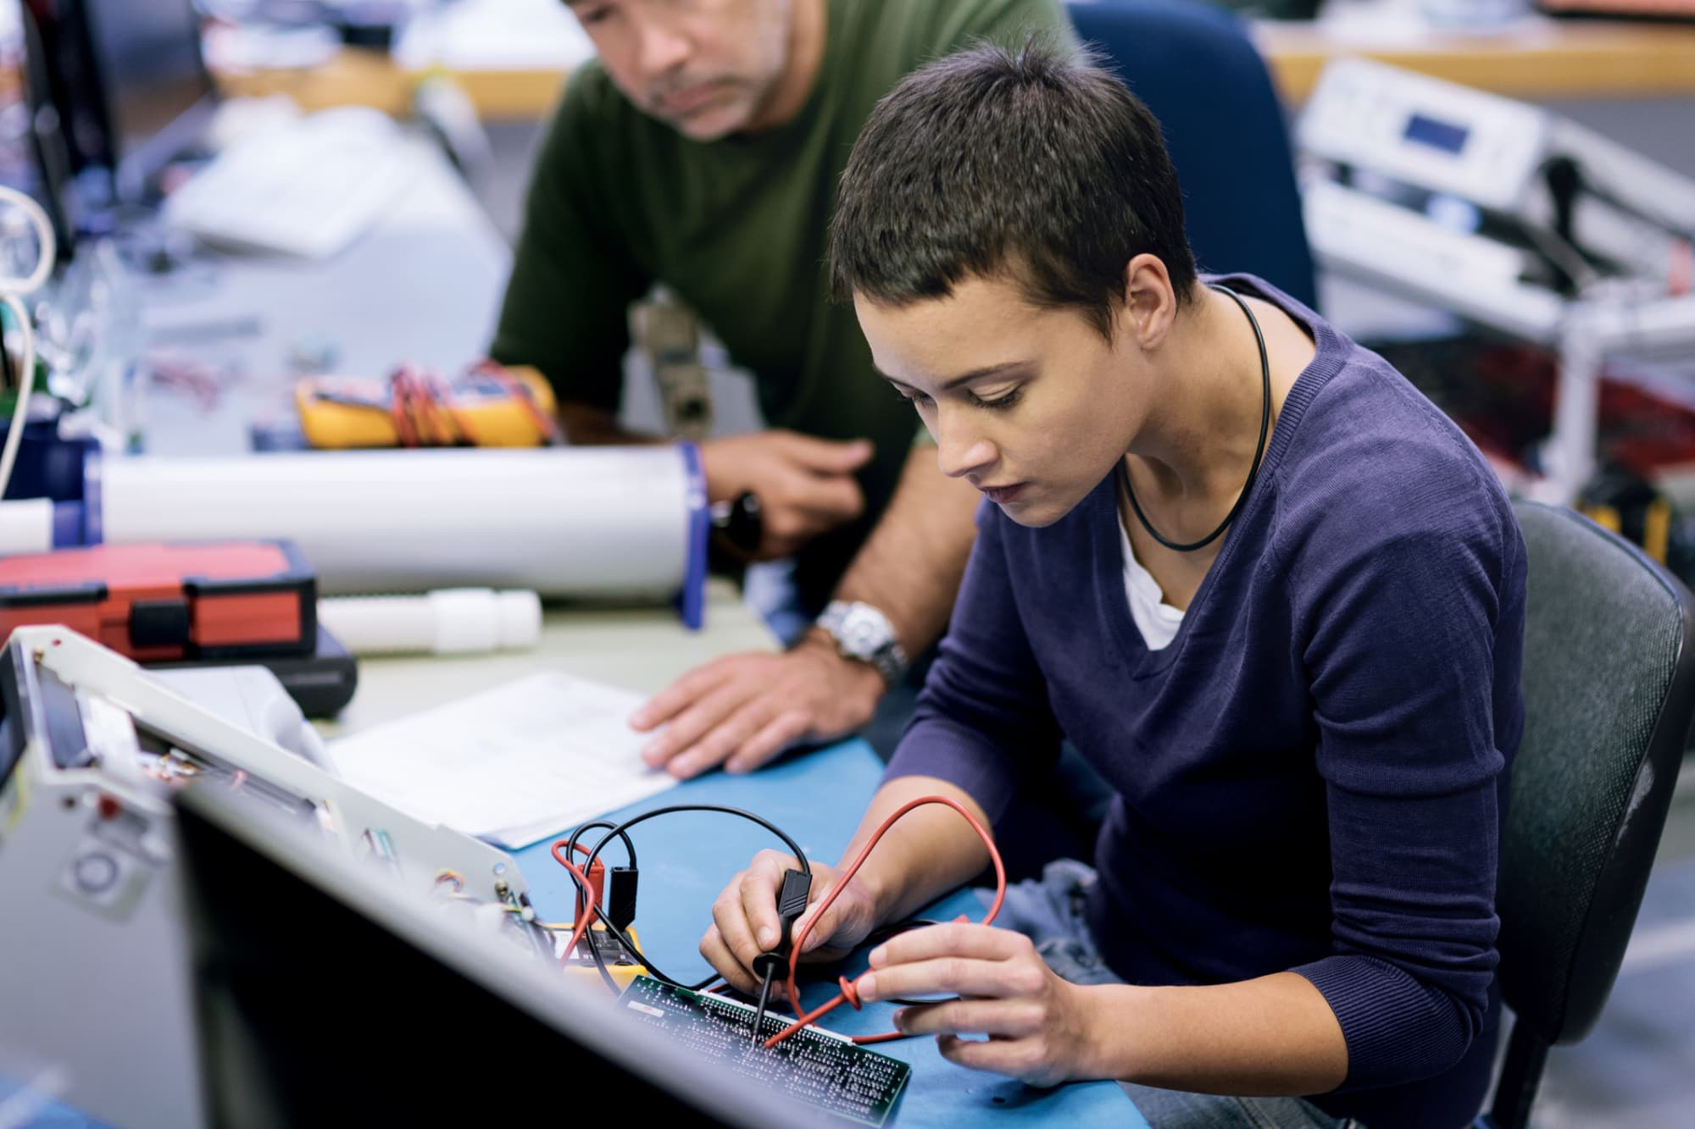

Slide 21


Thank You!

